Slide 1

Novedades en el desarrollo con Xamarin: Optimizaciones y librerías esenciales
Sergio Castillo
Facilitador técnico en Pronet I.S.E.
@sergio_castillo

Slide 2

What is Xamarin?

Slide 3

An open source app platform
from Microsoft for
building modern & performant
iOS, Android, macOS,
watchOS, & tvOS apps with .NET.

Slide 4

Xamarin App Architecture
.NET
C#
C#
C#
Shared C#
Business Logic • Platform APIs • User Interface
Shared C# codebase • 100% native API access • High performance

Slide 5












Native API Access

Slide 6

Xamarin.Essentials
Secure Settings
Sms
Preferences
Flashlight
Clipboard
Gyroscope
Magnetometer
Geolocation
Phone Dialer
Device Display Info
Email
Device Info
Battery
Compass
Accelerometer
Screen Lock
Data Transfer
Text to Speech
Geocoding
File System
Connectivity
Vibration
aka.ms/xamarinessentials

Slide 7
Xamarin.Essentials: Cross-Platform Native APIs
.NET
C#
C#
C#
Xamarin.Essentials
Shared C#
Business Logic • User Interface

Slide 8
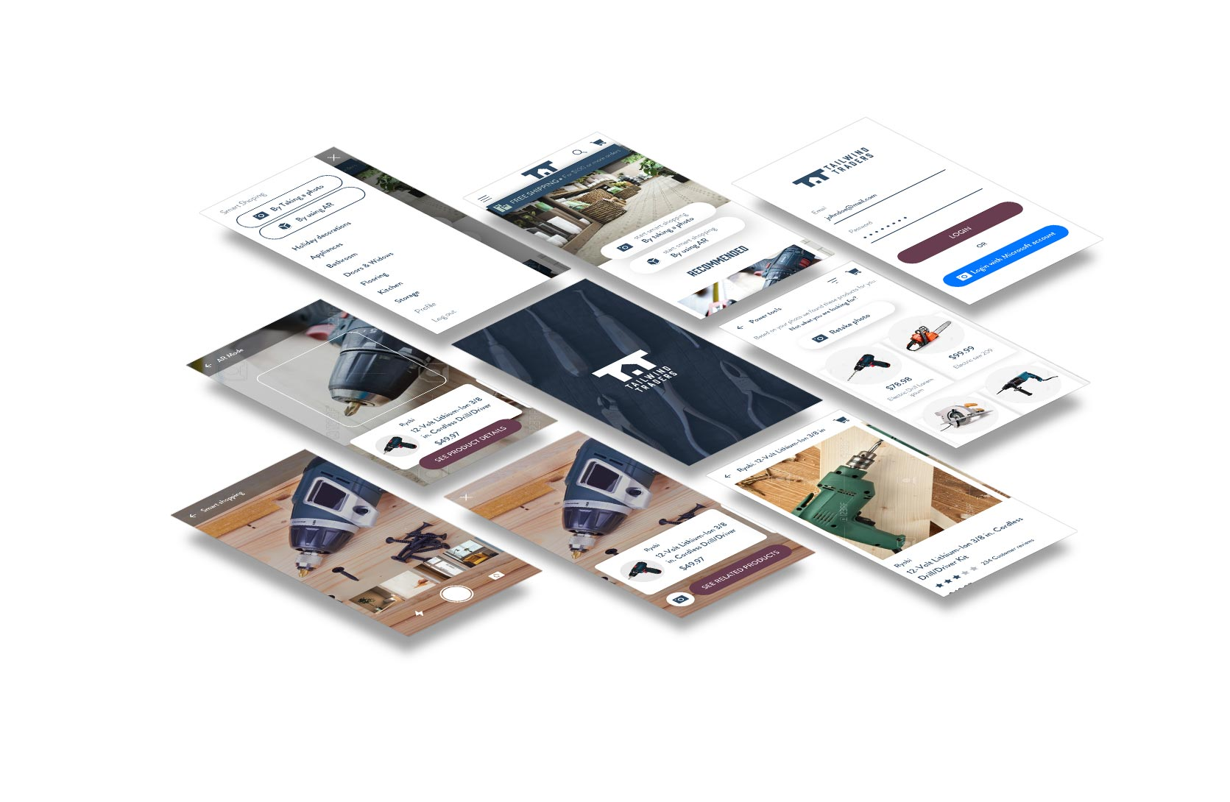
Xamarin.Forms

Slide 9
An open source mobile UI framework
from Microsoft for building
iOS, Android, & Windows apps with .NET
from a single shared codebase.

Slide 10
Xamarin.Forms: Cross-Platform Native UI
.NET
C#
C#
C#
Xamarin.Forms - UI
Xamarin.Essentials
Shared C#
Business Logic

Slide 11
Demo

Slide 12
Recap
Native iOS, Android, watchOS, tvOS, and macOS apps in C# & Visual Studio 2019 & Visual Studio 2019 for Mac with Xamarin
Share .NET Business Logic with Any App
Works with all your favorite libraries (JSON.NET, Refit, Polly, etc.)
Shared Native APIs with Xamarin.Essentials
Shared Native UI with Xamarin.Forms
Compatible with Latest Visual Studio Features
Live Share
IntelliCode
Previewers
iOS Remote Simulator

Slide 13
Visual Studio 2019 Launch Event
Novedades en Visual Studio 2019 (Javier Vela)
Qué debes conocer de .Net Core 3.0. (Hugo Biarge)
Trabajo en equipo con GIT y Pull Requests (Roberto Sanz)
Novedades en el desarrollo con Xamarin: Optimizaciones y librerías esenciales (Sergio Castillo)
Machine Learning en VS2019 y, IA que estamos, ¡pair programming con Live Share! (Alejandro Giménez y Gabriel García)

